Slide 1
Implementasi Struktur Data graph
Program Studi Diploma III Teknik Informatika
Fakultas Ilmu Terapan
Universitas Telkom

Slide 2
Graph?
Graf G = (V, E), yang dalam hal ini:
V = himpunan tidak-kosong dari simpul-simpul (vertices)
= { v1 , v2 , ... , vn }
E = himpunan sisi (edges) yang menghubungkan sepasang simpul
= {e1 , e2 , ... , en }

Slide 3
Definisi Graf
V = { 1, 2, 3, 4 }
E = {(1, 2), (2, 3),
(1, 3), (1, 3), (2, 4),
(3, 4), (3, 4), (3, 3)}
= { e1, e2, e3, e4, e5,
e6, e7, e8}
sisi e₃ = (1, 3) dan sisi e₄ = (1, 3) dinamakan sisi-ganda (multiple edges atau paralel edges)
sisi e₈ = (3, 3) dinamakan gelang atau kalang (loop)
1
e
e
4
1
e
3
e
2
2
e
8
e
6
3
e
5
e
7
4

Slide 4
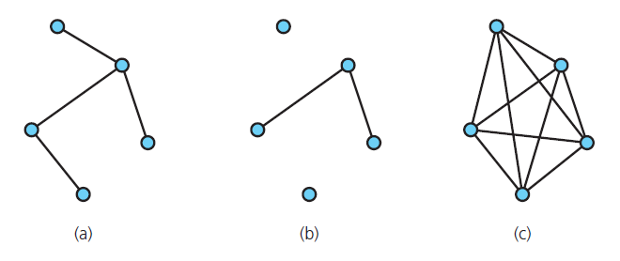
Terminology
FIGURE 20-3 Graphs that are (a) connected; (b) disconnected; and (c) complete

Slide 5
Terminology
Simple path: passes through vertex only once
Cycle: a path that begins and ends at same vertex
Simple cycle: cycle that does not pass through other vertices more than once
Connected graph: each pair of distinct vertices has a path between them
Undirected graphs: edges do not indicate a direction
Directed graph, or digraph: each edge has a direction

Slide 6
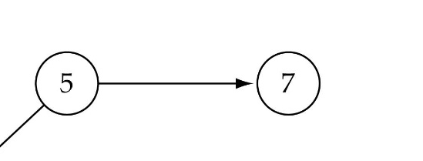
Graph terminology
Adjacent nodes: two nodes are adjacent if they are connected by an edge
Path: a sequence of vertices that connect two nodes in a graph
Complete graph: a graph in which every vertex is directly connected to every other vertex
5 is adjacent to 7
7 is adjacent from 5

Slide 7
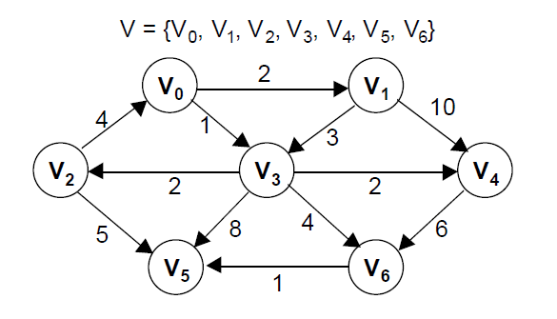
Terminology
degree (of a vertex): # of adjacent vertices
for directed graph
in-degree
out-degree
weighted graph
each edge have
weighted/cost

Slide 8
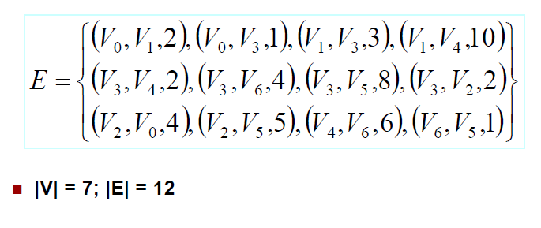
Weighted graph

Slide 9

Trees vs graphs
Trees are special cases of graphs!!

Slide 10
Representasi Graph
1. Matriks Ketetanggaan (adjacency matrix)
2. Matriks Bersisian (incidency matrix)
3. Senarai Ketetanggaan (adjacency list)

Slide 11
Matriks Ketetanggaan
Matriks ketetanggaan:
1 2 3 4

Slide 12
Matriks ketetanggaan:
1 2 3

Slide 13
Matriks ketetanggaan:
1 2 3 4

Slide 14
Matriks ketetanggaan:
1 2 3 4

Slide 15
Matriks Bersisian (incidency matrix)
Graph
Matriks Bersisian
e1 e2 e3 e4 e5

Slide 16
List ketetanggaan
List Ketetanggaan

Slide 17
List Ketetanggaan

Slide 18
Traversal (penelusuran)
DFS (Depth First Search)
BFS (Breadth First Search).
DFS : 1 2 4 8 5 6 3 7
BFS : 1 2 3 4 5 6 7 8

Slide 19
Depth-First Search
Goes as far as possible from a vertex before backing up
In depth-first search, edges are explored out of the most recently discovered vertex v that still has unexplored edges leaving it. When all of v’s edges have been explored, the search “backtracks” to explore edges leaving the vertex from which v was discovered.
This process continues until we have discovered all the vertices that are reachable from the original source vertex

Slide 20
Depth-First Search
Depth-first search is another strategy for exploring a graph
Explore “deeper” in the graph whenever possible
Edges are explored out of the most recently discovered vertex v that still has unexplored edges
When all of v’s edges have been explored, backtrack to the vertex from which v was discovered

Slide 21
Depth-First Search
Algorithm getDepthFirstTraversal(originVertex) traversalOrder = a new queue for the resulting traversal order vertexStack = a new stack to hold vertices as they are visited Mark originVertex as visited traversalOrder.enqueue(originVertex) vertexStack.push(originVertex) while (!vertexStack.isEmpty()){ topVertex = vertexStack.peek() if (topVertex has an unvisited neighbor){ nextNeighbor = next unvisited neighbor of topVertex Mark nextNeighbor as visited traversalOrder.enqueue(nextNeighbor) vertexStack.push(nextNeighbor) } else // all neighbors are visited vertexStack.pop() } return traversalOrder

Slide 22
A depth-first traversal visits a vertex, then a neighbor of the vertex, a neighbor of the neighbor, and so on, advancing as far as possible from the original vertex. It then backs up by one vertex and considers another neighbor. The order in which these neighbors are visited is not specified and can depend on the graph’s implementation.
Use a stack in building a DFS
We begin by pushing the origin vertex into the stack. When the vertex at the top of the stack has an unvisited neighbor, we visit and push that neighbor onto the stack. If no such neighbor exists, we pop the stack. The traversal order is the order in which vertices are added to the stack.
We can maintain this traversal order in a queue.

Slide 23
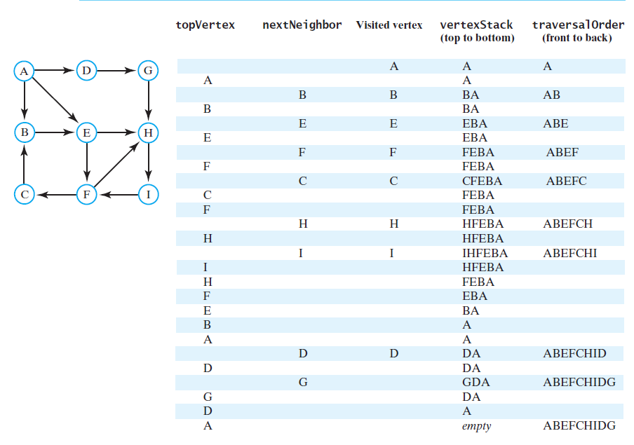

Slide 24
Breadth-First Search
Visits all vertices adjacent to vertex before going forward
Breadth-first search uses a queue
A breadth-first traversal visits a vertex and then each of the vertex’s neighbors before advancing.
The order in which these neighbors are visited is not specified and can depend on the graph’s implementation

Slide 25
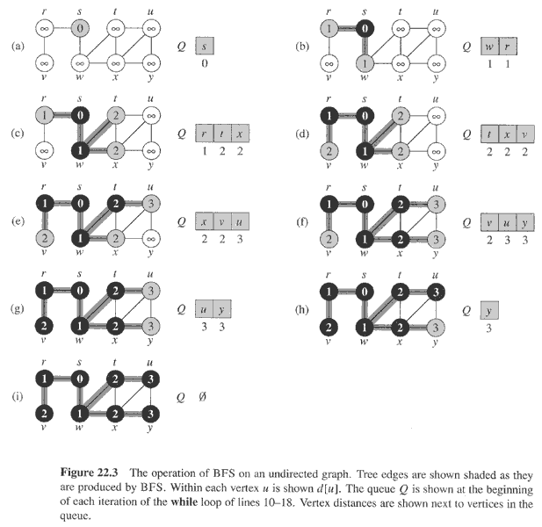
Copyright © The McGraw-Hill Companies, Inc. Permission required for reproduction or display.

Slide 26
Breadth-First Search
“Explore” a graph, turning it into a tree
One vertex at a time
Expand frontier of explored vertices across the breadth of the frontier
Builds a tree over the graph
Pick a source vertex to be the root
Find (“discover”) its children, then their children, etc.

Slide 27
Breadth-First Search
Algorithm getBreadthFirstTraversal(originVertex) traversalOrder = a new queue for the resulting traversal order vertexQueue = a new queue to hold vertices as they are visited Mark originVertex as visited traversalOrder.enqueue(originVertex) vertexQueue.enqueue(originVertex) while (!vertexQueue.isEmpty()) { frontVertex = vertexQueue.dequeue() while (frontVertex has a neighbor) { nextNeighbor = next neighbor of frontVertex if (nextNeighbor is not visited){ Mark nextNeighbor as visited traversalOrder.enqueue(nextNeighbor) vertexQueue.enqueue(nextNeighbor) } } } return traversalOrder

Slide 28
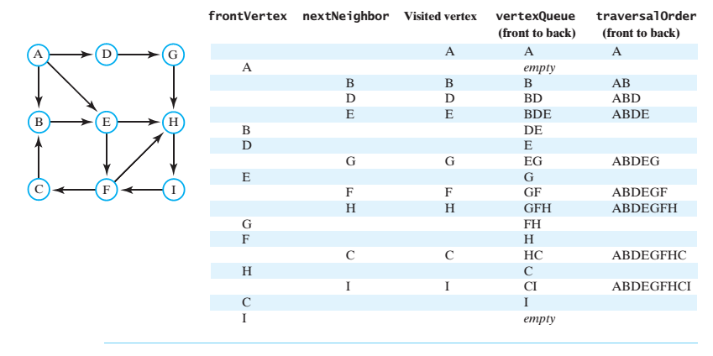

Slide 29
Breadth-First Search: Example
r
s
t
u
∞
∞
∞
∞
∞
∞
∞
∞
v
w
x
y

Slide 30
r
s
t
u
∞
0
∞
∞
∞
∞
∞
∞
v
w
x
y
Q:
s

Slide 31
r
s
t
u
1
0
∞
∞
∞
1
∞
∞
v
w
x
y
Q:
w
r

Slide 32
r
s
t
u
1
0
2
∞
∞
1
2
∞
v
w
x
y
Q:
r
t
x

Slide 33
r
s
t
u
1
0
2
∞
2
1
2
∞
v
w
x
y
Q:
t
x
v

Slide 34
r
s
t
u
1
0
2
3
2
1
2
∞
v
w
x
y
Q:
x
v
u

Slide 35
r
s
t
u
1
0
2
3
2
1
2
3
v
w
x
y
Q:
v
u
y

Slide 36
r
s
t
u
1
0
2
3
2
1
2
3
v
w
x
y
Q:
u
y

Slide 37
r
s
t
u
1
0
2
3
2
1
2
3
v
w
x
y
Q:
Ø

Slide 38
Shortest path

Slide 39
Length of weighted graph
Let G be a weighted graph. The length (or weight) of a path is the sum of the weights of the edges of P. That is, if P = ((v0,v1), (v1,v2), . . . , (vk−1,vk)), then the length of P, denoted w(P), is defined as
The distance from a vertex u to a vertex v in G, denoted d(u,v), is the length of a minimum-length path (also called shortest path) from u to v, if such a path exists.
People often use the convention that d(u,v) =∞ if there is no path at all from u to v in G.

Slide 40
Dijkstra algorithm
Dijkstra Algorithm: greedy-method pattern for single-source shortest path problem.
Perform a “weighted” breadth-first search starting at the source vertex s.
In particular, we can use the greedy method to develop an algorithm that iteratively grows a “cloud” of vertices out of s, with the vertices entering the cloud in order of their distances from s.
Thus, in each iteration, the next vertex chosen is the vertex outside the cloud that is closest to s.
The algorithm terminates when no more vertices are outside the cloud (or when those outside the cloud are not connected to those within the cloud)
At which point we have a shortest path from s to every vertex of G that is reachable from s.

Slide 41
Algorithm ShortestPath(G, s): Input: A directed or undirected graph G with nonnegative edge weights, and a distinguished vertex s of G. Output: The length of a shortest path from s to v for each vertex v of G. Initialize D[s] = 0 and D[v] = ∞for each vertex v 6= s. Let a priority queue Q contain all the vertices of G using the D labels as keys. while Q is not empty do {pull a new vertex u into the cloud} u = value returned by Q.removeMin( ) for each edge (u,v) such that v is in Q do {perform the relaxation procedure on edge (u,v)} if D[u]+w(u,v) < D[v] then D[v] = D[u]+w(u,v) Change the key of vertex v in Q to D[v]. return the label D[v] of each vertex v

Slide 42
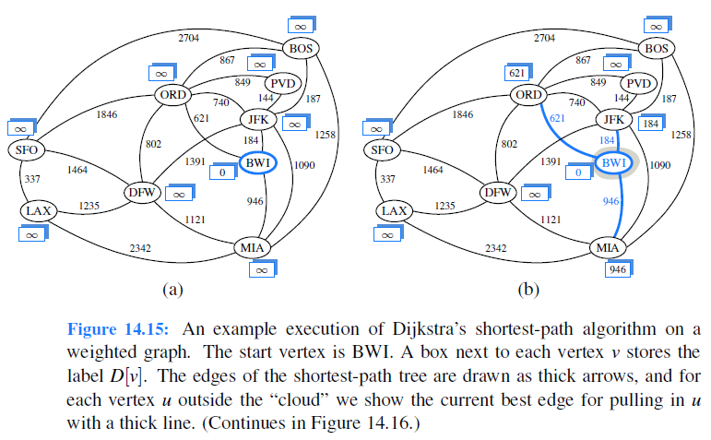

Slide 43
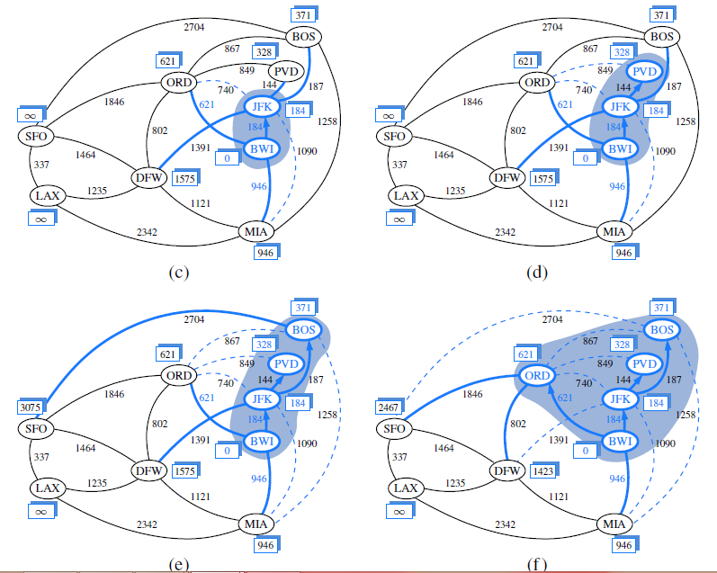

Slide 44
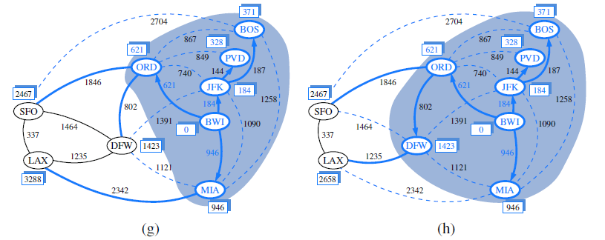
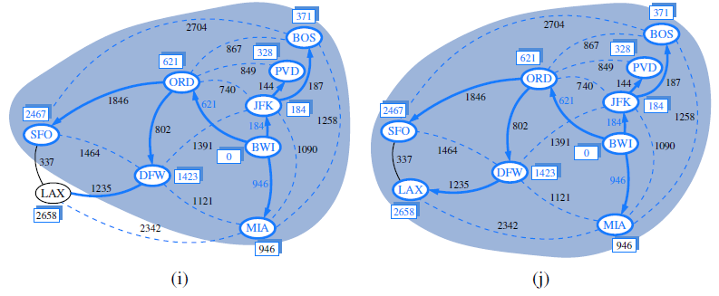

Slide 45
References
Tjokorda Agung Budi Wirayuda, “PI1043 Struktur Data: Graph Data Structure”.
Carrano, F., M., Lectures Graphs. Data Structures and Abstraction With Java, Prentice Hall, 2012
Lectures CS 308 – Data Structures, “Graphs”.
Denny, “Struktur Data & Algoritme – Graphs”, Fakultas Ilmu Komputer Universitas Indonesia 2001
Lectures CS 332: Algorithms, “Graph Algorithms “
Michael T. Goodrich, Roberto Tamassia and Michael H. Goldwasser , Data Structures and Algorithms in Java™, John Wiley&Sons, 2014

